Slide 1
DynamoDB Manager
2020/05/06

Slide 2
DynamoDB Manager
DB Overview
Manage Tables
Manage Table Items
DB Name: My Test DB
Table Number: 5
Size: 1GB

Slide 3
DynamoDB Manager
DB Overview
Manage Tables
Manage Table Items
Create a table
Delete tables

Slide 4
DynamoDB Manager
DB Overview
Manage Tables
Manage Table Items
Choose a table…

Slide 5
Filter…
V | Select All
V | A0
V | A1
Manage Table Items
Field 1 | < > = <= >= != | 1
Table Name
Confirm
Cancel
Choose a table…
Update Items
Update | Field 1 (key) | Field 2 (not key)
Delete/Edit/Reverse Change | A0 | B0
 | A1 | B1
 | A2 | B2
 | A3 | B3
Total: 4 records
Update
Add Items
(見後頁)

Slide 6

Add Items
Add Attribute
Field 1 (hash key) | Field 2 (range key) | Field 3 | Field 4
A0 | B0 | C0
A1 | B1 |  | D0

Slide 7

Add Items
Add Item
Add Attribute
 | Field 1 (hash key) | Field 2 (range key) | Field 3 | Field 4
 | A0 | B0 | C0
 | A1 | B1 |  | D0
Add

Slide 8
Create a table
* Table Name:
Attribute Definitions
(dropdown)
Add
Delete All
X
String
Enter attribute name…
X
Boolean
Enter attribute name…
Key Schema
* Hash key:
Choose an attribute…
* Range key:
Choose an attribute…
Provisioned Throughput
* Read Capacity Units:
5
* Write Capacity Units:
5
Clear All Fields
Create
Notes:
effect: https://www.w3schools.com/howto/howto_css_login_form.asp

Slide 9
Delete
 | Table A
 | Table B
 | Table C
Refresh
Deselect All
Select All
Delete
Notes:
effect: https://www.w3schools.com/howto/howto_css_login_form.asp

Slide 10
確認訊息 (覆蓋整版)
Confirmation
Action Result
Are you sure you want to XXX?
Success
OK
Cancel
Confirm
Error
X
There’s something wrong!

Slide 11
Backup

Slide 12
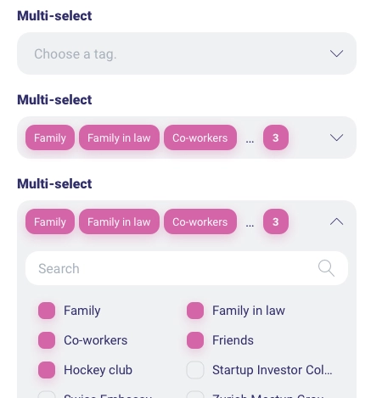

Slide 13
Create
Read
Update
Delete

Slide 14
Add table records
X
Add Records
+
*
Field 1:
Enter data value
*
Field 2:
Enter data value
Field 3:
Enter data value
*
Field 1:
Enter data value
*
Field 2:
Enter data value
Field 3:
Enter data value
Cancel
Confirm

Slide 15




Manage Table Items
Query Results
Total: 3 items
 | Field 1 (key) | Field 2 (not key) | Field 3 (not key)
 | A0 | B0 | C0
 | A1 | B1 | C1
 | A2 | B2 | C2
 | A3 | B3 | C3
新增的item用綠背
Delete All
Reset All
Cancel
Update
點下使後面方位可編輯
點下使所有X被點並顯示被點
點下使所有修改還原

Slide 16
一進到此畫面就先把此table的前100筆data都列出來
Manage Table Items
Table Name
(toggle to expand / withdraw)
Choose a table…
Query Conditions
Choose an attribute…
X
Attribute X:
…
Enter a number
X
Attribute Y:
…
Enter a string
Attribute Z:
…
(true / false dropdown)
X
Choose…
(operator dropdown)
Clear all conditions
Query
Query Results
(見下頁)
Notes:
Operator dropdown:
Number:
<
>
<=
>=
=
!=
between
String:
<
>
<=
>=
=
!=
Boolean: (NA)

